Slide 1

Practice Your Programming with Katas
Session 3: beep beep beep beepbeep beepbeepbeep

Slide 2

Week 3: http://eca-katas/session3
MI:7 have been able to put a keylogger on the President of Urmania’s phone. They want to be able to read his text messages. Unfortunately it’s a Nokia 6110 and predates even predictive text.
Each keypress cycles through the numbers and letters, for example:
Pressing ‘222’ gives the letter C
Pressing ‘0’ once gives a space, twice the number 0.
A pause (indicated by a space character in the input) separates two characters on the same number key.
Write a function that accepts:
A set of keystrokes (string)
It should return:
The corresponding text message

Slide 3
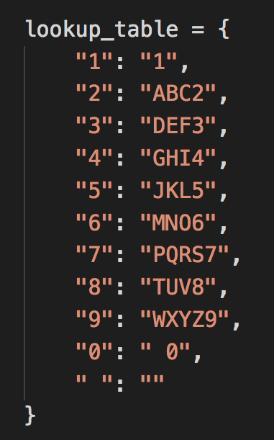
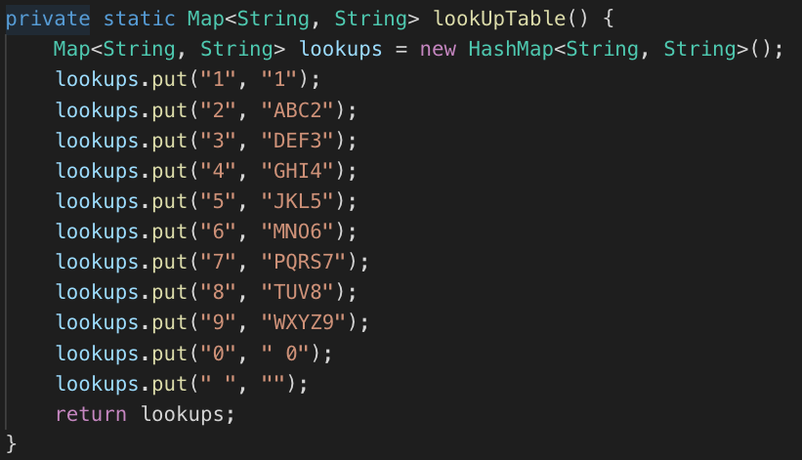
To start with

Slide 4
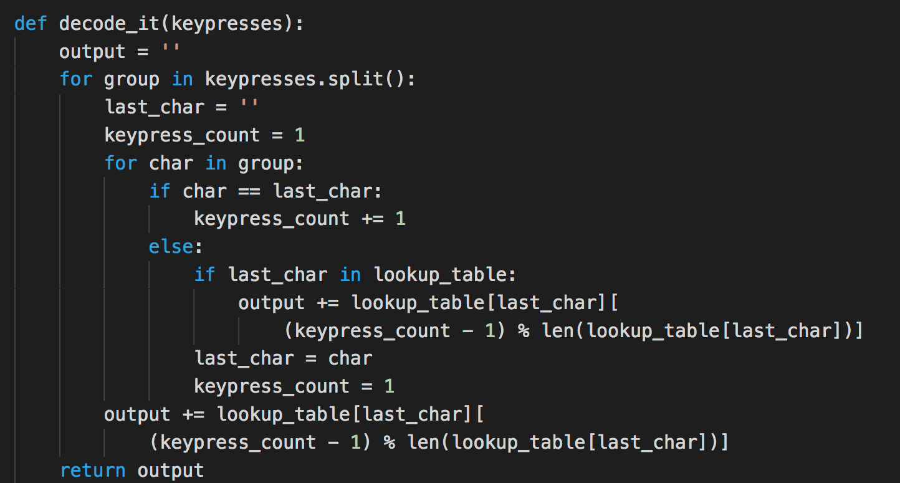
Clunky, much like the Nokia 6110
Notes:
There’s a redundant for loop in here. My first attempt at these exercises is often far from perfect too.

Slide 5
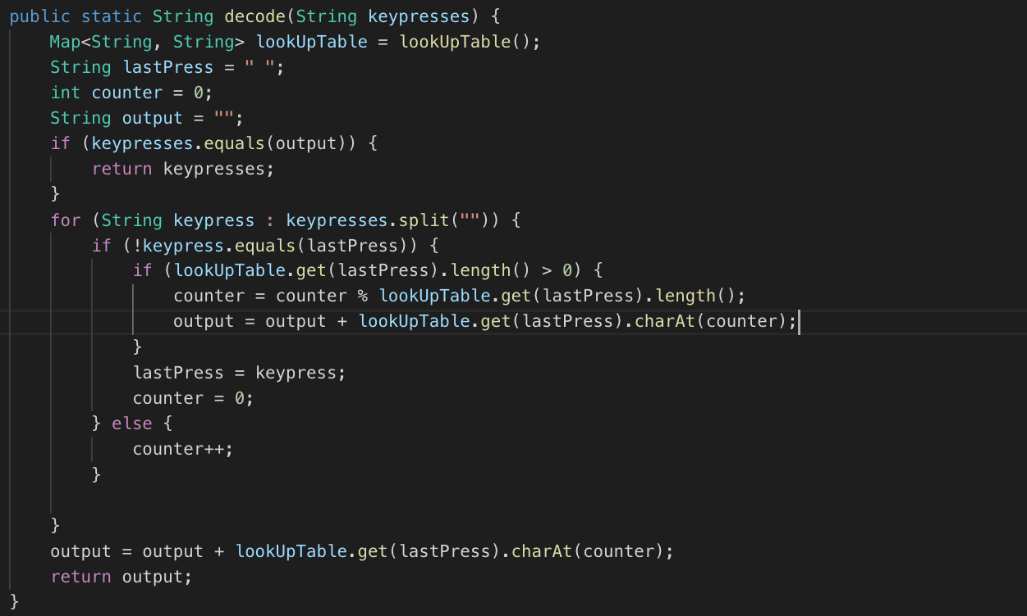
Equally Clunky

Slide 6
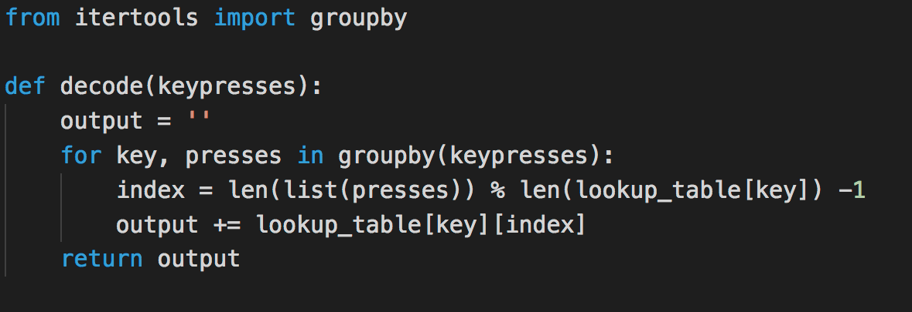
itertools gets things done

Slide 7
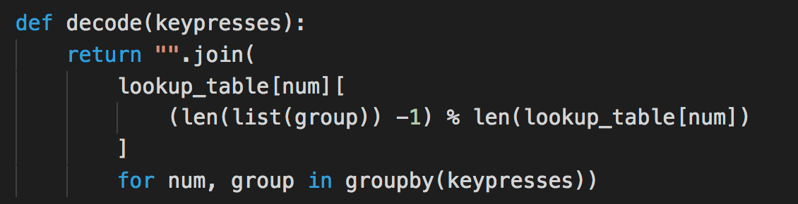
Ditching the explicit output
Next time: Emit T, Xen!

